Slide 1
Chapter 15

Slide 2
Key Religions
Deism:
Relied on reason rather than revelation, science rather than the Bible
Believed in God
Unitarians
God only existed in 1 person; Jesus is not divine
Free will, possibility of salvation through good works

Slide 3
Religion is becoming more liberal, in need of a revival……. Sound familiar?
First Great Awakening was a reaction to the Enlightenment, Second Great Awakening was a reaction to Deism and Unitarianism.
Second Great Awakening:
“Born Again Christians”
Reorganized churches into new sects or branches
Encouraged new reform movements: prison, temperance, women’s movement, slavery
AP LOVES TO TEST ON THIS!!!

Slide 4
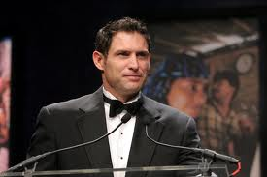
A Desert Zion in Utah
Joseph Smith:
Church of Jesus Christ of Latter-Day Saints (Mormons)
Mormons became a powerful collective unit in terms of voting
1844, Smith is murdered
Brigham Young:
1846-47 led the Mormons to Utah
Becomes a prosperous frontier society
Due to polygamy issues, Utah is not admitted as a state until 1896

Slide 5
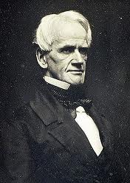
Free Schools for a Free People
Education was seen as way to instill republican values
Focus in school was more on discipline than learning
Horace Mann:
Key reformer of education, promoted more schools, longer days, and expanded curriculum
Noah Webster:
Dictionary helped standardize the American language
Textbooks and readers used by millions of Americans
Black Slaves in the South were legally forbidden from learning to read and write

Slide 6
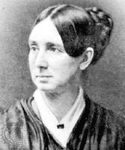
An Age of Reform
Second Great Awakening inspired Americans to battle evils
Puritan vision of a perfected society: no cruelty, war, intoxicating drink, discrimination, and slavery
Women played a key role in reform movements: could escape the confines of home
Other changes in Society:
Prison reform, imprisonment for debt, mental health reform (DOROTHEA DIX!!!)

Slide 7
Temperance and Prohibition
Heavy Drinking decreased labor efficiency and fouled the sanctity of the family
American Temperance Society (Boston, 1826):
Urged drinkers to quit alcohol, organized children’s clubs
Neal S. Dow:
“Father of Prohibition”
Maine Law of 1851 prohibited the manufacture and sale of intoxicating liquor, encouraged other states to pass laws
Openly flouted, later declared unconstitutional or repealed

Slide 8
Women in Revolt
Ind. Rev. separated women and men into sharply distinct roles
Elizabeth Cady Stanton: advocated suffrage for women
Susan B. Anthony: lecturer of women’s rights
Seneca Falls Convention (1848)
Stanton read a “Declaration of Sentiments” which declared that “all men and women are created equal”
Launched the modern women’s rights movement

Slide 9
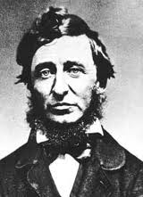
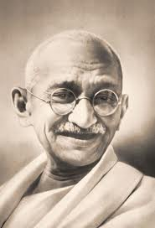
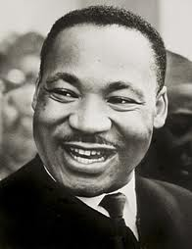
Trumpeters of Transcendentalism
Thank you for spreading my message!
Truth "transcends" the senses
Every person possesses an inner light that can illuminate the highest truth and put him/her in direct touch with God, or the "Oversoul.“
People can become one with nature: Thoreau lived in woods for two years
Walden
Ralph Waldo Emerson:
Advocated self-reliance and self-improvement
Henry David Thoreau:
On the Duty of Civil Disobedience – protest of the Mexican American War
Influenced Gandhi and MLK
Thank you David!

